Slide 1


Prediction of Rainfall using ML techniques
Project Mentor: Dr.Arash Rafiey
Student Name: Sahana Vasudev
Student ID: 991973717

Slide 2
Abstract
Accurate prediction of heavy rainfall is a major problem for the meteorological department as it is closely associated with the economy and life of human beings. It is a cause for natural disasters like floods and drought which are encountered by people across the globe every year.
The techniques incorporated for the project are machine learning and deep learning, which are subsets of artificial intelligence. The most important aspect of a machine learning model is the data. Since, everything is trained and tested on the given data set, it plays an important role. The raw dataset is made to undergo data-prepossessing tasks such as data cleaning, scaling, transformation etc. This helps the model to predict the values in an accurate manner.

Slide 3
Introduction
    Accurate prediction of heavy rainfall is a major problem for the meteorological department as it is closely associated with the economy and life of human beings. It is a cause for natural disasters like floods and drought which are encountered by people across the globe every year. Accuracy of rainfall prediction has great importance in countries like India whose economy is largely dependent on agriculture. Due to the dynamic nature of atmosphere statistical techniques failed to provide good accuracy for rainfall forecasting. Due to non-linearity of rainfall data machine learning approach is a better technique.
    Problem Statement : Application of Machine Learning techniques to predict rainfall and its intensity so that appropriate action can be taken to minimize the damage.
    Problem Statement :Application of Machine Learning techniques to predict rainfall and its intensity so that appropriate action can be taken to minimize the damage.
Existing Systems
Numerical Rainfall Prediction- The basic idea of this method is to sample the state of the fluid(atmosphere) at a given time and apply equations of thermodynamics and fluid dynamics to estimate the atmospheric conditions after some time in the future.

Slide 4


EXISTING SYSTEMS
Persistence- This system relies upon the weather conditions of today to predict the atmospheric conditions of tomorrow. This system heavily relies upon constant weather condition and hence the forecasts are inaccurate in fluctuating weather condition.
The barometer- This is a good old method which is used for the measurement of pressure and changes in pressure have been used to forecast the Rainfall. Larger changes in pressure imply larger Rainfall fluctuations.
Numerical Rainfall Prediction- The basic idea of this method is to sample the state of the fluid(atmosphere) at a given time and apply equations of thermodynamics and fluid dynamics .

Slide 5
Models used:
Linear Regression
Lasso Regression
Ridge Regression
XG Boost
Cat Boost

Slide 6

LINEAR REGRESSION
Linear regression is a straight way to deal with demonstrating the connection between a scalar reaction (or ward variable) and at least one logical factors (or free factors).
The instance of one informative variable is called straightforward direct relapse. For more than one informative variable, the procedure is called numerous Linear Regression
This term is unmistakable from multivariate Linear Regression , where different corresponded subordinate factors are anticipated, as opposed to a solitary scalar variable.
A linear regression line has an equation of the form Y = a + b X, where X is the explanatory variable and Y is he dependent variable. The slope of the line is b, and a is the intercept (the value of y when x = 0).

Slide 7

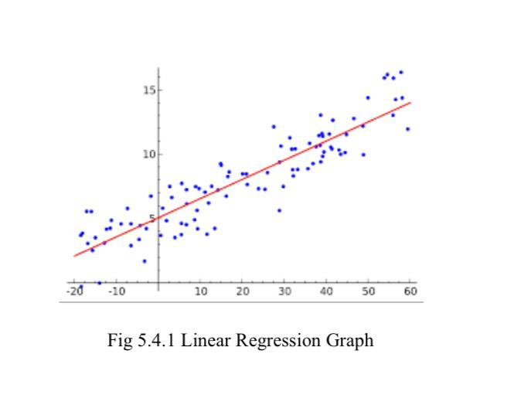
The most widely recognized technique for fitting a relapse line is the strategy for least-squares.
This technique computes the best-fitting line for the watched information by limiting the aggregate of the squares of the vertical deviations from every datum point to the line (in the event that a point lies on the fitted line precisely, at that point its vertical deviation is 0). Since the deviations are first squared, at that point added, there are no scratch-offs among positive and negative qualities.

Slide 8
LASSO REGRESSION
Lasso regression is a regularization technique. It is used over regression methods for a more accurate prediction. This model uses shrinkage.
Shrinkage is where data values are shrunk towards a central point as the mean. The lasso procedure encourages simple, sparse models (i.e. models with fewer parameters).
This particular type of regression is well-suited for models showing high levels of multicollinearity or when you want to automate certain parts of model selection, like variable selection/parameter elimination.

Slide 9
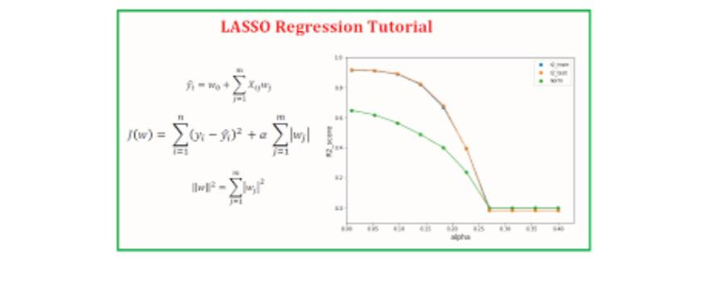
Lasso Regression uses L1 regularization technique (will be discussed later in this article). It is used when we have more features because it automatically performs feature selection.

Slide 10
RIDGE REGRESSION
Ridge Regression is a method for examining various relapse information that experience the ill effects of multicollinearity.
When multicollinearity happens, least squares gauges are unprejudiced, however their fluctuations are enormous so they might be a long way from genuine worth. By adding a level of inclination to the relapse gauges, edge relapse diminishes the standard mistakes. It is trusted that the net impact will be to give gauges that are progressively solid.
Another one-sided relapse method,
head segments relapse, is likewise accessible in NCSS. Edge relapse is the more well known of the two techniques.

Slide 11
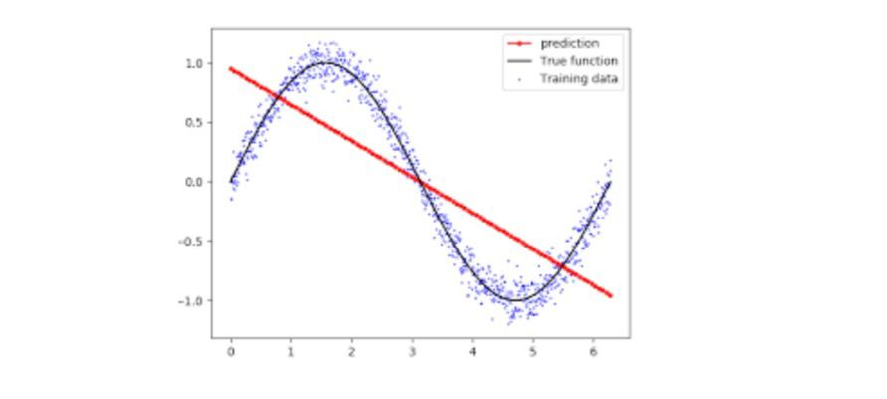
In ridge regression, the initial step is to normalize the factors (both needy and free) by deducting their methods and partitioning by their standard deviations. This causes a test in documentation, since we should some way or another show whether the factors in a specific recipe are normalized or not. To keep the introduction straightforward, we will offer the accompanying general expression and afterward disregard normalization and its confounding documentation.

Slide 12
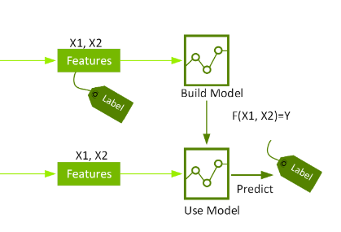
XG BOOST
XG Boost which stands for Extreme Gradient Boosting, is a scalable, distributed gradient boosted decision tree (GBDT) machine learning library. It provides parallel tree boosting and is the leading machine learning library for regression, classification, and ranking problems.

Slide 13
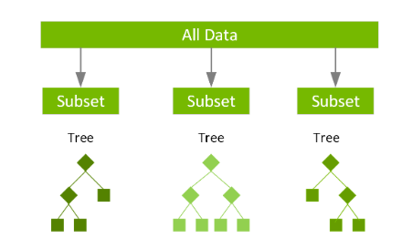
XG Boost is a scalable and highly accurate implementation of gradient boosting that pushes the limits of computing power for boosted tree algorithms, being built largely for energizing machine learning model performance and computational speed. With XG Boost, trees are built in parallel, instead of sequentially like GBDT. It follows a level-wise strategy, scanning across gradient values and using these partial sums to evaluate the quality of splits at every possible split in the training set.

Slide 14
CATBOOST
Cat Boost not only does it build one of the most accurate model on whatever dataset you feed it with requiring minimal data prep. Cat Boost also gives by far the best open source interpretation tools available today AND a way to productionize your model fast.
CatBoost offers easy-to-use interfaces. The CatBoost algorithm can be used in Python with scikit-learn, R, and command-line interfaces. Fast and scalable GPU version: the researchers and machine learning engineers designed Cat Boost at Yandex to work on data sets as large as tens of thousands of objects without lagging.

Slide 15
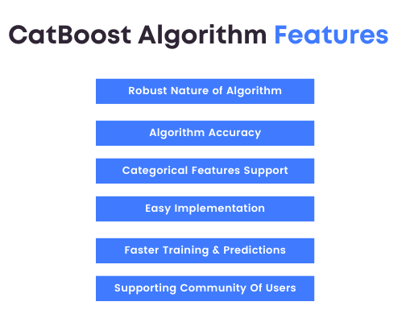
Training your model on GPU gives a better speedup when compared to training the model on CPU. To crown this improvement, the larger the dataset is, the more significant the speedup. Cat Boost efficiently supports multi-card configuration. So, for large datasets, use a multi-card configuration.

Slide 16
RESULTS
1) Linear Regression Model: 72.9% Accuracy
2) Lasso Regression Model: 72.8% Accuracy
3) Ridge Regression Model: 72.8% Accuracy
4) XGBoost Model: 85% Accuracy
5) CatBoost Model: 39% Accuracy

Slide 17
REFERENCES
[1]Xingjian Shi Zhourong Chen Hao Wang Dit-Yan Yeung, Convolutional LSTM Network: A Machine Learning Approach for Precipitation Nowcasting.
[2]Ismayilov, Amin & Aghayev, Amil & Ismayilov, A & Suleymanov, T. (2016). THE EFFECTS OF FLOODS ON THE ECOLOGICAL STATE. Herald of the Russian Academy of Sciences. 8.
[3]Su, Ya & Gao, Xinbo & Li, Xuelong & Tao, Dacheng. (2012). Multivariate Multilinear Regression. IEEE transactions on systems, man, and cybernetics. Part B, Cybernetics : a publication of the IEEE Systems, Man, and Cybernetics Society. 42. 10.1109/TSMCB.2012.2195171.
[4]Yalcin, Mustak & Ayhan, Tuba & Yeniceri, Ramazan. (2020). ArtificialNeuralNetworkModels.10.1007/978-3-03017840-6_2.
[5]Chandrasegar Thirumalai, M Lakshmi Deepak, K Sri Harsha, K Chaitanya Krishna. Heuristic prediction of rainfall using machine learning techniques. International Conference on Trends in Electronics and Informatics ICEI 2017.

Slide 18

THANK YOU

